Slide 1
MULTILAYER NETWORK

Slide 2
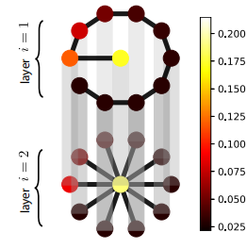
PROBLEM
Create the multilayer network as the below figure:

